Slide 1

Function Point Analysis
CSET-324: Software Project Management

Slide 2
Introduction
FPA measures the functional size of a software application based on what it does for the user.
It uses Function Points as a unit, similar to km or kg, instead of counting lines of code.
Developed by A.J. Albrecht at IBM in the 1980s to improve software size estimation.
The International Function Point User Group (IFPUG) was formed in 1986 to standardize the method.
FPA is technology-independent and focuses on functionality delivered to the end user.

Slide 3
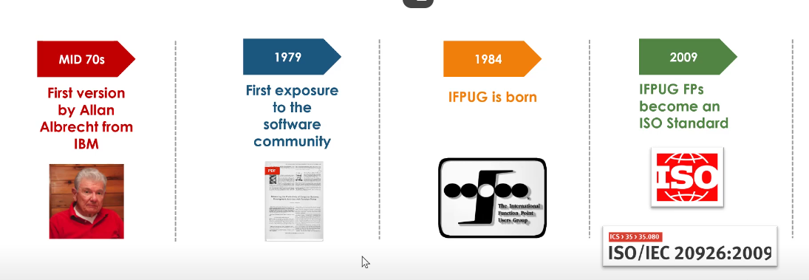
History of FP

Slide 4
FPA Key Concepts
The size in FPA is determined by counting the number of inputs, outputs, queries, internal files and external files in the system and adjusting that total for the functional complexity of the system.
  Data at Rest = Tables/Storage
  Data in motion = Transactions
Application Boundary = Within the application to be developed
Elementary process = A series of steps, which moves data (interwoven EPs form a system), smallest unit of activity that is meaningful to user.

Slide 5
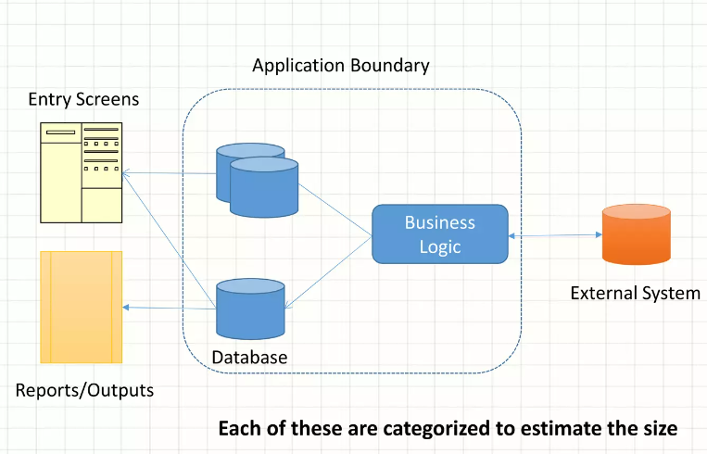
FPA Key Concepts
The application boundary carries user context
The boundary is not a technical concept
The data residing inside Business the boundary is data at rest
The data moving into or Reports/Outputs out of boundary is data in motion
Each of these are categorized to estimate the size

Slide 6
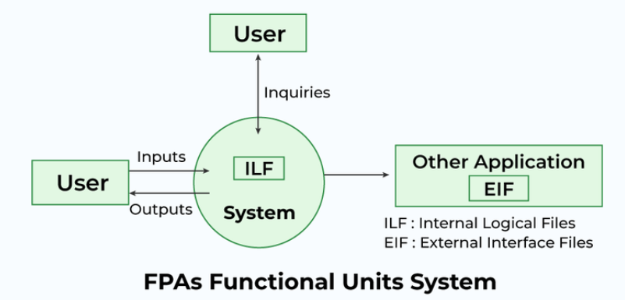
Components of FPA
(EQ)
(EI)
(EO)
Two Data Function Types (ILF, EIF)
Three Transactional Function Types. (EI, EO, IQ)

Slide 7
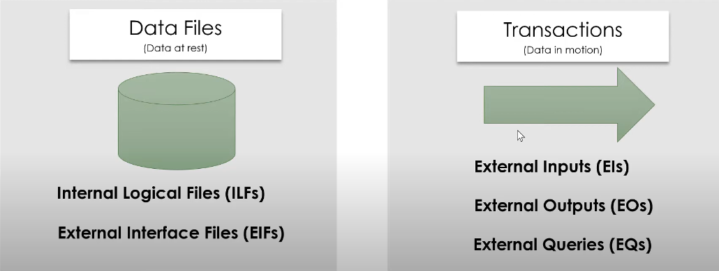
Elementary Processes

Slide 8
1. Internal Logical Files (ILF)
Definition: Logical groupings of data in a system, maintained by an end user(and application), are referred to as Internal Logical Files (ILF).
For example, a pilot may enter navigational data through a display in the cockpit prior to departure. The data is stored in a file for use and can be modified during the mission. Therefore, the pilot is responsible for maintaining the file that contains the navigational information.

Slide 9
2. External Interface Files (EIF)
Definition: Groupings of data from another system that are used only for reference purposes are defined as External Interface Files (EIF).
Explanation: The second Data Function a system provides an end user is also related to logical groupings of data. In this case the user is not responsible for maintaining the data. The data resides in another system and is maintained by another user or system. The user of the system being counted requires this data for reference purposes only.
For example, it may be necessary for a pilot to reference position data from a satellite or ground-based facility during flight. The pilot does not have the responsibility for updating data at these sites but must reference it during the flight.

Slide 10
Transactional Functions
These functions address the user's capability to access the data contained in ILFs and EIFs. This capability includes maintaining, inquiring and outputting of data. These are referred to as Transactional Functions.
External Inputs (El)
It gives the user the capability to maintain the data in ILF's through adding, changing and deleting its contents. In this case the pilot is utilizing a transaction referred to as an External Input (EI).
For example, a pilot can add, change and delete navigational information prior to and during the mission.

Slide 11
Transactional Functions
2) External Output (EO)
This Transactional Function gives the user the ability to produce outputs.
For example, a pilot has the ability to separately display ground speed, true air speed and calibrated air speed. The results displayed are derived using data that is maintained and data that is referenced. In function point terminology the resulting display is called an External Output (EO).
3) External Queries (EQ)
This Transactional Functions addresses the requirement to select and display specific data from files. To accomplish this a user inputs selection information that is used to retrieve data that meets the specific criteria. In this situation there is no manipulation of the data. It is a direct retrieval of information contained on the files.
For example, if a pilot displays terrain clearance data that was previously set, the resulting output is the direct retrieval of stored information. These transactions are referred to as External Inquiries (EQ).

Slide 12
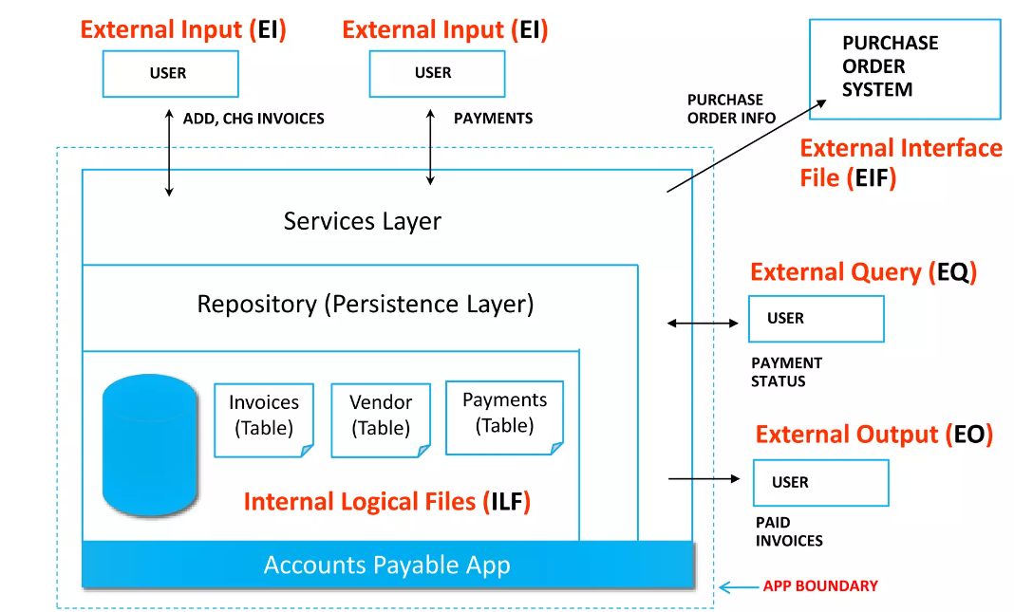
Elementary Processes through E-Commerce example

Slide 13
Calculation of Function Points
FPA= CAF* Count function of UFP
Calculation of CAF:
Step 1: CAF = [0.65 + 0.01 * sum (F_{i})]
Where sum (F_{i}) = Complexity Adjustment Factor
F = 14 * Scale
There are 14 software characteristics (shown in next slide) taken to calculate the software complexity and a Scale is assigned to each factor.
Rate each factor on a scale of 0 to 5.
0 - No Influence
1 - Incidental
2 - Moderate
3 - Average
4 - Significant
5 - Essential

Slide 14
Number of factors considered ( F_{i} )
1.Does the system require reliable backup and recovery ?
2.Is data communication required ?
3.Are there distributed processing functions ?
4.Is performance critical ?
5.Will the system run in an existing heavily utilized operational environment ?
6.Does the system require on line data entry ?
7.Does the on line data entry require the input transaction to be built over multiple screens or operations ?
8.Are the master files updated on line ?
9.Is the inputs, outputs, files, or inquiries complex ?
10.Is the internal processing complex ?
11.Is the code designed to be reusable ?
12.Are conversion and installation included in the design ?
13.Is the system designed for multiple installations in different organizations ?
14.Is the application designed to facilitate change and ease of use by the user ?

Slide 15
Step-2: Calculate Unadjusted Function Point (UFP).​
Table 1 : Functional units with weighting factors
All the parameters mentioned in the Table 1 are assigned some weights that have been determined by experience.
The functional complexities are multiplied with the corresponding weights against each function, and the values are added up to determine the UFP (Unadjusted Function Point) of the subsystem.
Functional Units | Weighting factors
 | Low | Average | High
External Inputs (EI) | 3 | 4 | 6
External Output (EO) | 4 | 5 | 7
External Inquiries (EQ) | 3 | 4 | 6
External logical files (ILF) | 7 | 10 | 15
External Interface files (EIF) | 5 | 7 | 10

Slide 16
The procedure for the calculation of Unadjusted Function Point (UFP) is given in table shown below.
Table 2: UFP Calculation Table
Domain Characteristics | Count |  | Weighting Factor |  |  | Count
 |  |  | low | avg | high
Number Of User Inputs |  | * | 3 | 4 | 6
Number Of User Outputs |  | * | 4 | 5 | 7
Number Of User Enquiries |  | * | 3 | 4 | 6
Number Of Files |  | * | 7 | 10 | 15
Number Of External Interfaces |  | * | 5 | 7 | 10
Count Total

Slide 17
Example 1:
Given the following values, compute function point when all complexity adjustment factor (CAF) and weighting factors are average.
User Input = 50
User Output = 40
User Inquiries = 35
User Files = 6
External Interface = 4
Explanation:
Step-1: As complexity adjustment factor is average (given in question), hence, scale = 3.
F = 14 * 3 = 42
Step-2: CAF = 0.65 + ( 0.01 * 42 ) = 1.07
Step-3: As weighting factors are also average (given in question) hence we will multiply each individual function point to corresponding values in TABLE.UFP.
Total Count= (50*4) + (40*5) + (35*4) + (6*10) + (4*7) = 628
Step-4: Function Point = 628 * 1.07 = 671.96

Slide 18
Example 2
Study of requirement specification for ABC project has produced following results –
need for
- 7 inputs,
- 10 outputs,
- 6 inquiries,
- 17 files &
- 4 external interfaces.
Input & external interface FP attributes are of Average Complexity & all other FP attributes are of – Low Complexity
Determine – adjusted FPs assuming Complexity Adjustment Value is → 32

Slide 19
Calculation of UFP
Domain Characteristics | Count |  | Weighting Factor |  |  | Count
 |  |  | Simple | Average | Complex
Number Of User Inputs | 7 | X |  | 4 |  | 28
Number Of User Outputs | 10 | X | 4 |  |  | 40
Number Of User Enquiries | 6 | X | 3 |  |  | 18
Number Of Files | 17 | X | 7 |  |  | 119
Number Of External Interfaces | 4 | X |  | 7 |  | 28
Count Total |  |  |  |  |  | 233

Slide 20
Calculation of FP
FP = Count Total (UFP) * {(0.65 + 0.01) * Sum(Fi)}
= 233 * {(0.65 + 0.01) * 32}
= 233 * 0.97
= 226.01
Hence, adjusted FP = 226.01

Slide 21
Example
An application has the following:
10 low external inputs,
12 high external outputs,
20 low internal logical files,
15 high external interface files,
12 average external inquiries,
and a value of complexity adjustment factor of 1.10.
What are the unadjusted and adjusted function point counts ?

Slide 22

Thank you
any questions

